Slide 1
《英语国家社会与文化入门》(上册）
The Society and Culture
of Major English-Speaking Countries
An Introduction
(Book One)

Slide 2
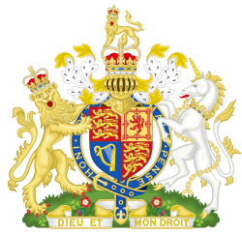
The United Kingdom of Britain and Northern Ireland
Unit 10 Sports, Holidays and Festivals in Britain

Slide 3
Quiz
Give the English and a brief explanation for the following:
1 英国足球协会
2 板球
3 温布尔登
4 复活节
5 篝火之夜

Slide 4
Focal Points
Sports:
football
“Football hooligans”
FA
tennis
Wimbledon
cricket
golf
horse racing
the Royal Ascot
Holidays and Festivals:
Christmas
Easter
Bonfire Night
the Battle of the Boyne
Orange Marches
St Patrick’s Day
Hogmanay
Burns Night
Halloween
Eisteddfod

Slide 5
The Unit Is Divided into Two Sections
Sports
Holidays and Festivals

Slide 6
I. Sports
Sports in British life
Football
Tennis
Cricket
Golf
Horse Racing, Hunting and Equestrianism

Slide 7
I. Sports
Sports in British life:
Going for a walk in the country, working in the garden or watching sports on TV--these are all ways in which many British people like to relax on weekends. Because many of the sports we see played throughout the world today were born in Britain, the history of such activities is of interest to people everywhere. In the past, Britain was a mainly agricultural society with most people involved in farming. Britain was also a very religious society and the influence of the Christian Church on peoples’ lives was very great. Such influences are still evident in today’s sports and leisure activities.

Slide 8
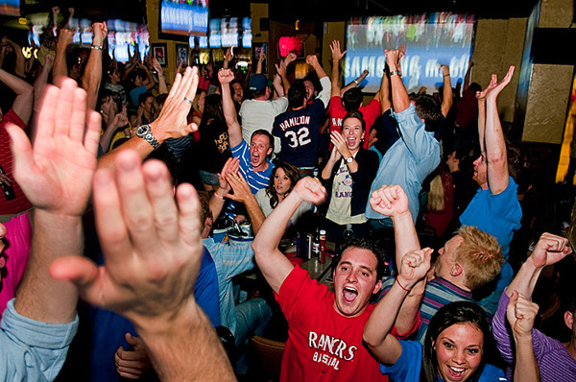
Watching sports on TV in a pub

Slide 9
Football
The idea of sports having seasons--like the football season -- comes from the natural rhythms of an agricultural society. Football is a boisterous sport still played in winter and early spring when the weather is cool and often wet. There are legends that suggest that games like football and rugby actually derived from the “sport” of ancient warriors celebrating victory. During the Renaissance the idea began to emerge that some sports were too rough for aristocratic young men. In Shakespeare’s time, football was played in the cities as well as the countryside. Drinking hard went along with playing hard, which led to unrefined behaviour.

Slide 10
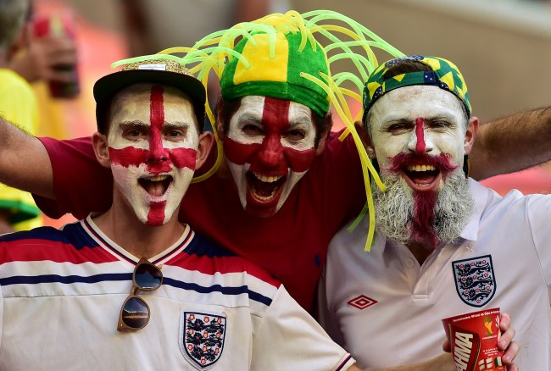
Football
During the Brazil
World Cup 2014, fans of England Team paint their faces and sing or chant football songs , and it is not too difficult to imagine their warrior-ancestors.

Slide 11
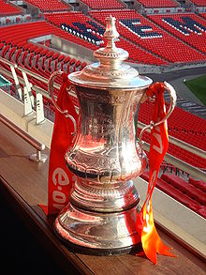
Football
The Football Association, known as the FA ,is the governing body of football in England, and the Crown dependencies of Jersey, Guernsey and the Isle of Man. Formed in 1863, it is the oldest football association in the world and is responsible for overseeing all aspects of the amateur and professional game in its territory. The FA is a member of both UEFA and FIFA and holds a permanent seat on the International Football Association Board(IFAB). All of England's professional football teams are members of the Football Association. The major teams compete in for a trophy title known as the FA Cup.

Slide 12
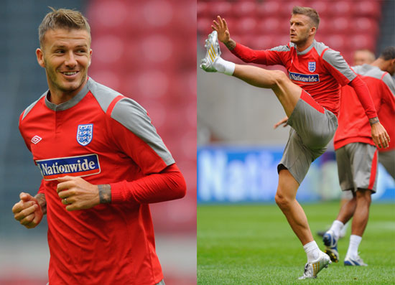
Football
David Beckham is a retired English footballer. He has played for Manchester United, Milan, Real Madrid, the England national football team, etc. In 2004 he was named in the FIFA 100 list of the world's greatest living players.

Slide 13
Tennis
Tennis was invented in Britain and it owes its origins, literally, to the Church. Church records indicate that by the mid-fifteenth century, people were making a game of bouncing a ball off the side of their local churches or cathedrals, first using the hand, and later a racquet.
The Wimbledon Championships or simply Wimbledon, is the oldest tennis tournament in the world, and widely considered the most prestigious. It has been held since 1877. It is one of the four Grand Slam tennis tournaments (Majors), the others being the Australian Open, the French Open and the US Open.

Slide 14
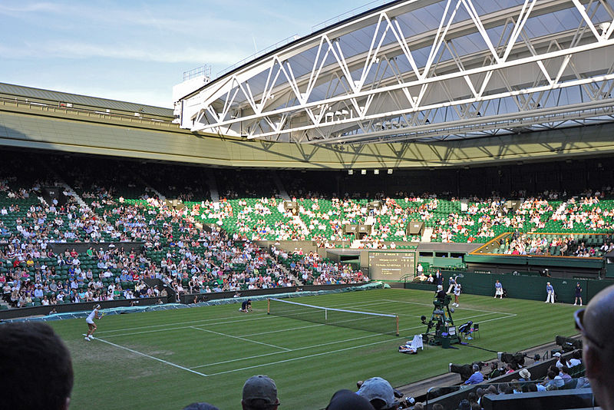
Tennis
Wimbledon, actually a London suburb, is where the world’ best players gather to compete on grass courts. It is one of the major events of the British sporting calendar. Besides actually watching the tennis matches, other activities closely associated with the “Wimbledon fortnight” are eating strawberries and cream, drinking champagne and hoping that it doesn’t.

Slide 15
Cricket
Cricket was one of the very first team sports in Britain to have organised rules and to be played according to the same rules nationally.
In the nineteenth century, cricket became a sport associated with the upper classes. It was a kind of a “snob” game played by boys who attended public schools. Cricket also became popular in places where the public school system was adapted, like in the colonies of Australia, New Zealand, India and Pakistan.
As generations of public school boys grew up to become the civil servants and rulers of the UK and its colonies, cricket became associated with a set of moral values, in particular the idea of “fair play” which characterised British government.
British English is still full of references and phrases to cricket.
In modern Britain, people from all walks of life play cricket.

Slide 16
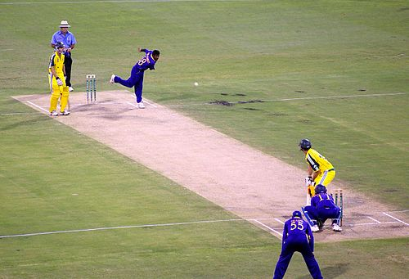
Cricket
Cricket is a bat-and-ball game played between two teams of 11 players each on a field at the centre of which is a rectangular 22-yard long pitch. Each team takes its turn to bat, attempting to score runs, while the other team fields. matches do not last just a few hours. They can go on for days.

Slide 17
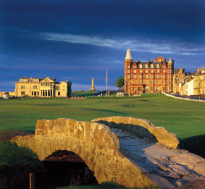
Golf
The modern game of golf originated in 15th-century Scotland. The game is played on a course, in general consisting of an arranged progression of either nine or 18 holes. Today avid golfers around the world dream of playing on the famous and ancient golf course at St Andrews, not far from Edinburgh in Scotland

Slide 18
Horse Racing
The true sport of British Kings (and Queens) is horse racing. Organised national horse races have been held throughout Britain for hundreds of years. At the heart of medieval life was the horse, a symbol of authority and wealth and necessary to travelling, hunting and warfare. The age of English chivalry is full of stories, songs, poems and depictions of the brave Knight on his steed.
Sports which involve the riding of horses are still considered rather snobbish or aristocratic sports because the average British family cannot afford to own a horse.

Slide 19
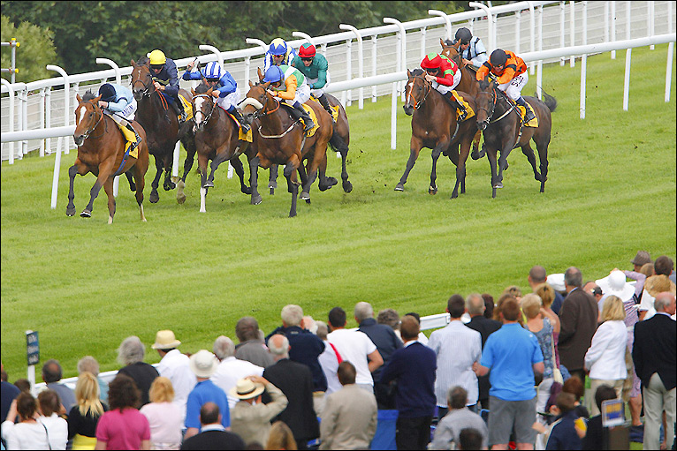
Horse racing attracts large crowds of spectators. Many people enjoy betting on the horses. In any town centre people can go into a betting shop and place a bet on the horses.

Slide 20
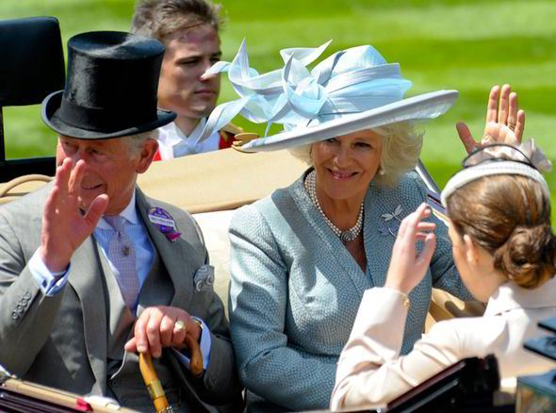
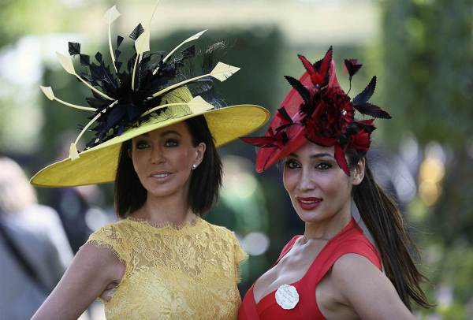
Royal Ascot is the biggest social event associated with horse racing, attended by Queen Elizabeth II and various members of the Royal Family such as the Price of Wales (below).
At Royal Ascot people dress up to show how fashionable they are, and women especially wear very elaborate and exotic hats.

Slide 21
II. Holidays and Festivals
Knowing a little bit about British holidays and customs and their origins is a good way of understanding what Britons find important in their lives and communities.
Throughout the year the British celebrate many holidays which reflect the religious, historical, social and cultural diversity of their country.
Some holidays are celebrated throughout the country and mark important events of the Christian calendar. Other holidays are based on local customs and traditions which reflect the variety of experience in different regions.
Holiday customs have changed as times have changed. Holidays remind us of how cultures change and influence each other; they also give us an opportunity to share in the rich cultural heritage of the United Kingdom.

Slide 22
Religious Holidays
Although Britain remains a mainly Christian nation, most Britons do not go to church regularly or engage in Christian worship.
Because of immigration and changing beliefs, most of the world’s religions are practised in Britain, with sizeable Hindu, Jewish, Muslim and Sikh communities and numerous smaller groups.
Although many Christian festivals are observed they have been adapted to fit the needs of a modern, secular society.

Slide 23
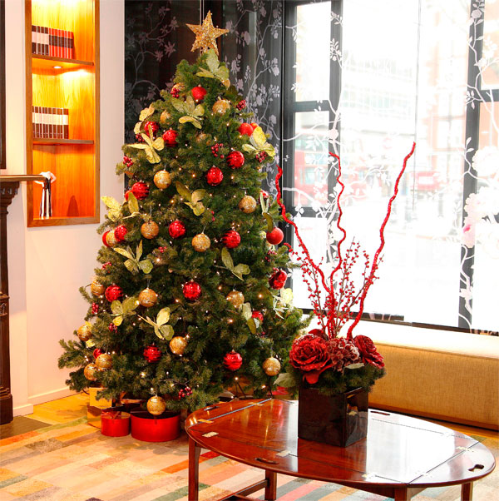
Christmas
Christmas, December 25th, is the biggest and best loved British holiday. Christmas commemorates the birth of Jesus Christ. Nowadays, Christmas is celebrated by most Britons by exchanging gifts and Christmas cards, preparing holiday foods, and decorating homes and workplaces with coloured lights, Christmas trees and ornaments.

Slide 24
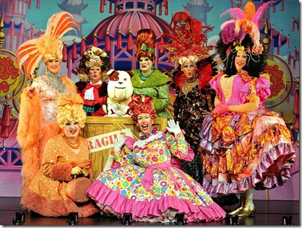
Christmas
Pantomimes is a great Christmas tradition in London. This tradition seems to have developed in the 1800’s as a form of low opera, based on Children’s fairy stories.
There are three Christmas traditions which are particularly British:
-putting on the Christmas Pantomime, a comical musical play;
-hearing the Queen give her Christmas message to her realm over the television and radio;
-Boxing Day, which falls on the day after Christmas.

Slide 25
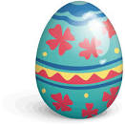
Easter
For church-goers it is Easter, not Christmas, which is the most important Christian festival.
Easter commemorates the Crucifixion and Resurrection of Jesus Christ.
It occurs in the spring, and the main symbol of Easter is the Easter egg, originally a Christian symbol of new life. Nowadays people give each other chocolate or candy Easter Eggs
Christmas and Easter have been adopted and celebrated by non-Christian people who emphasise the secular rather than the religious aspects of the holidays.

Slide 26
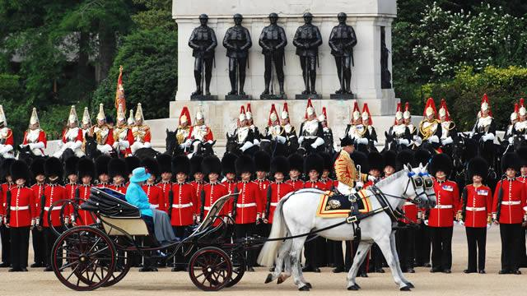
National Holidays
Queen’s Birthday: One of Britain’s most impressive and colourful festivals happens on the second Saturday in June when the Queen’s Birthday is officially celebrated by “Trooping the Colour” around Buckingham Palace in London. The pomp and ceremony surrounding the Queen inspecting her troops draws hundreds of people.

Slide 27
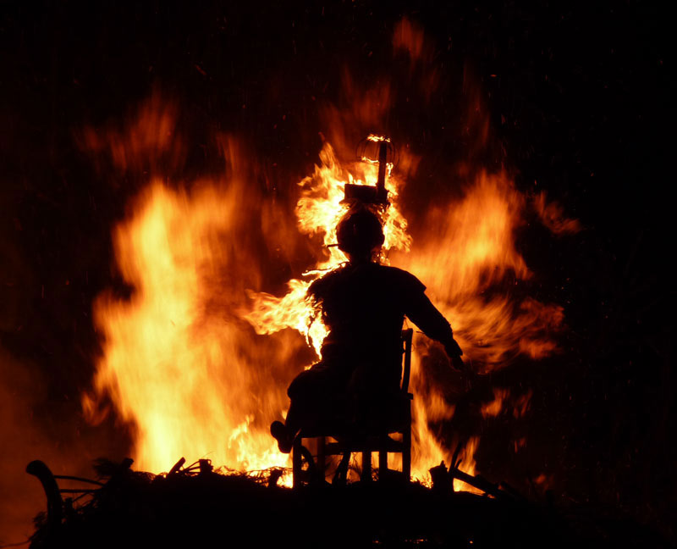
Bonfire Night
Bonfire Night: One truly English holiday is Bonfire Night, also called Guy Fawkes Night, celebrated in the early autumn. The origin of this holiday was the failed plan to blow up the British Parliament and kill the Protestant King in 1605. The biggest Bonfire Night celebration is held in the small medieval town of Lewes, where torchlight parades wind through the narrow streets. At the end of the parade, giant effigies of the Pope and Guy Fawkes are blown up with fireworks.

Slide 28
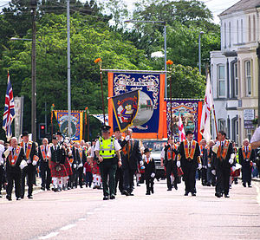
Orange marches
Orange marches, or Orange walks, are a series of parades held annually by members of the Orange Order on a regular basis during the summer in Northern Ireland, Scotland, and occasionally in England, the Republic of Ireland , and throughout the Commonwealth. These typically build up to 12 July celebrations which mark Prince William of Orange’s victory over King James II at the Battle of the Boyne in 1690.

Slide 29
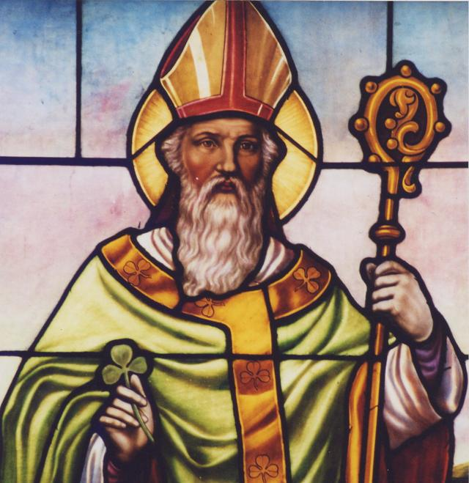
St Patrick’s Day
Northern Irish Catholics celebrate the birthday of the patron saint of Ireland, St Patrick, on March 17 each year. Patrick was a Catholic bishop who lived in the 5th century and is thought to have brought Christianity to Ireland.

Slide 30
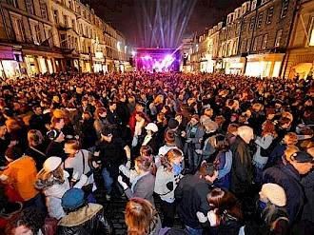
Hogmanay
In Scotland, New Year’s Eve called Hogmanay--is the major winter celebration, and overshadows Christmas. Hogmanay is the Scots word for the last day of the year How Hogmanay is celebrated varies throughout Scotland, but one widely practised custom is “first footing.” There is a superstitious belief that the first person to cross the threshold of a household in the New Year can bring luck and prosperity.

Slide 31
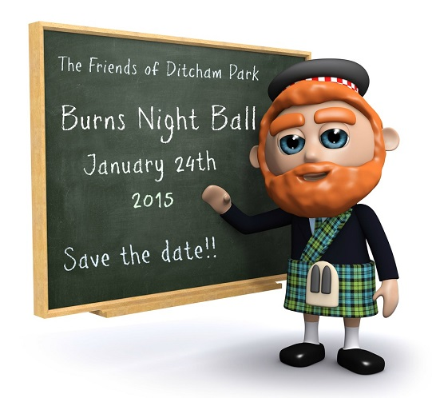
Burns Night
Each year Scottish people all over the world celebrate their most beloved national poet, Robert Burns, by holding a Burns Supper on the evening of his birthday (25 January). Burns wrote mainly in the Scots dialect and his poems drew on older traditions of Scottish folk songs and stories and so have a wide popular appeal.

Slide 32
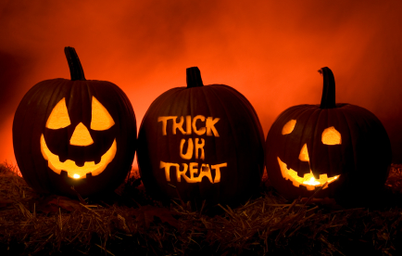
Halloween
Halloween is a Scottish festival that comes from the great feast of the pagan Celts which marked the arrival of the winter half of the year. The festival is dedicated to remembering the dead, including saints (hallows), martyrs, and all the faithful departed believers. Typical festive Halloween activities include “trick-or-treat”, attending costume parties, decorating, carving pumpkins into lanterns.

Slide 33
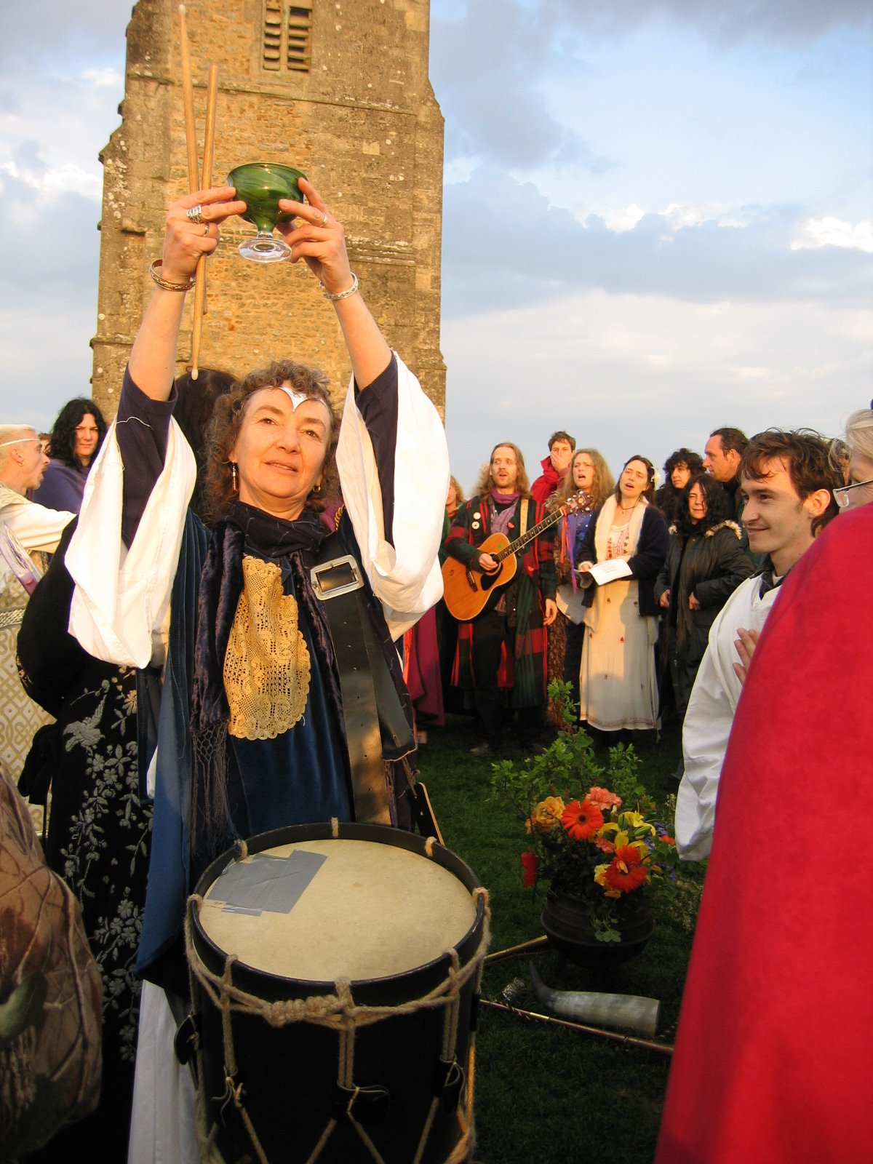
Eisteddfod
Eisteddfod is a Welsh festival that would remind people throughout the UK of Wales’ special cultural heritage. The Eisteddfod is now the largest popular festival of music making and poetry writing in Europe. At the Eisteddfod, tents and pavilions are erected around a big open space: in the different tents competitions are held to find the best choirs, translators, essayists and poets. The highlight is the crowning of the two bards who have written the best poems of the festival.

Slide 34
Questions for Discussion
A. Find some examples from the text to demonstrate how British sports, holidays and festivals reflect British history and culture.
B. Why is cricket very English? Why does the author believe that cricket was associated with a set of English values?
C. How do the British celebrate Christmas? In what way does this holiday and the ways of celebration in Britain reflect western cultural tradition in general and British traditions in particular?
D. In what way are the Welsh people different from England, Scotland, and Northern Ireland in celebrating their holidays?

Slide 35
The End
高等教育出版社
2015

